Slide 1
Exploratory data analysis
Dr. Van Kelly
Data Visualization
Yeshiva University 2017

Slide 2
2nd best life-changing advice I ever got
Son, those numbers are trying to tell you something. Why don't you go back and listen to what they are trying to say.
-- Prof. S. Hugh Paine (1973)*
*years before Tukey's book took EDA into the mainstream, but Paine had decades of informal experience with EDA at Argonne Labs.
Notes:
This was before Tukey's book took EDA into the mainstream, but Paine had decades of intuitive experience with exploratory statistics at Argonne Labs.

Slide 3
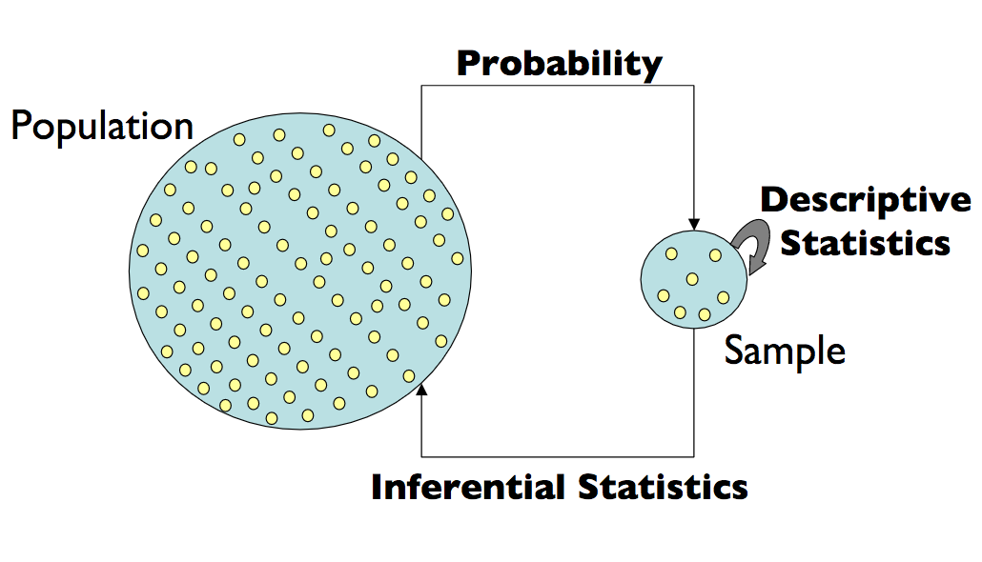
"Central Dogma" of Statistics
"EDA"
Rare, easy case: when the sample is the entire population

Slide 4
EDA
Before making inferences from data, examine all your variables
Why?
To listen to the data
catch mistakes and missing data
see patterns
try out useful transformations
find violations of statistical assumptions*
generate hypotheses
… and because if you don't you will have trouble later
Notes:
* not so much for us in this course

Slide 5
Types of Data
Categorical
Unordered
Quantitative
Discrete
Ordinal
Continuous
Domains:
Data Roles:
classifiers – tell which groups our data came from
inputs – things an experimenter controlled
outputs – effects observed and measured

Slide 6
Dimensionality of Data Sets
Data sets usually concern multiple subjects
Univariate: One variables per subject
Bivariate: Two variables per subject
Multivariate: Many variables measured per subject
When we explore a dataset our approaches can also be:
Univariate: examine one variable at a time
Bivariate: compare two variables at a time
Multivariate: relate many variables at a time

Slide 7
So, 6 kinds of EDA Techniques
 | Categorical Data | Numerical Data
Univariate | frequency tabulation histogram stem-and-leaf | central tendency spread, skew & kurtosis histogram stem-and-leaf box-and-whiskers
Bivariate | cross-tabulation 2-way histogram 2-way stem-and-leaf | correlation scatter plot 2-way histogram 2-way stem-and-leaf
Multivariate* | n-dimensional cross-tab 3d-histogram | correlation multiple regression 3d scatter plot
techniques can be either non-graphical or graphical
* multivariate techniques are follow-ons after univariate and bivariate

Slide 8
Categorical data, one variable

Slide 9

Category Tabulation
Dataset: roster of all undergrads at YU (name, gender, age, id, school, class, GPA, advisor, etc.)
Variable: school
Why don't things add up? (And they won't, usually.)
typos, blanks, and database nulls
"other"
merging datasets (lots can go wrong)
School | # | %
Total | 6031 | 100.0%
YC | 2562 | 42.5%
Stern | 2298 | 38.1%
Syms | 1145 | 19.0%
M.I.A. | 26 | 0.4%
Count of records, not sum of categories
(made-up figures)
Notes:
Other: there are HS students taking courses at YC, if they are in dataset, they will be "other"
During merges, data can be off by a column or can be out-of-sync time-wise
Is 0.4% outage significant? Probably not, but do 2 separate studies on small student subsets,
one by school and one not, we may compare apples to oranges.

Slide 10
Plain Old Bar Graphs
For bins of widely varying sizes, this can help
Chart either counts or percentages
Effective for up to ~25 bins
otherwise show N largest bins plus "other"
Pie charts are an alternative (serious tradeoffs)

Slide 11
"ASCII Bar Graph"
Most useful for small data sets
Can scale up with approximations (each 0 represents 100 students)
YC|00000000000000000000000000 Stern|000000000000000000000000 Syms|00000000000 other|
The basis of stem-and-leaf charts

Slide 12
Numerical data, one variable

Slide 13
All the preceding still applies
if…
domain has small, fixed number of numerical values
if not…
we can still fix things up with a little creativity
but in any case
there are other tools we should consider
Example #1: a small data set of responses in range 1-9
3 5 4 9 3 5 3 7 6 4 8 5 1 4 5 4 3 4 1 3 5 5 5 7 1 5 6 2 1 7 5 9 1 2 1 5 3 3 3 5 4 6 7 3

Slide 14
Bar Graphs of Discrete Numeric Data
1|000000
2|00
3|000000000
4|000000
5|00000000000
6|000
7|0000
8|0
9|00
Same as before
May be easier to find the "middle" in the ASCII version
What if the domain of values is large or even continuous?

Slide 15
Histograms with range bins
Let each bin represent an interval of values
each bin the same size
possible exception for first and last if there are values that are "way off" (outliers)
Ex: Dataset of 80 floating-point samples in [-1, 24]
bin size = 2, bin label is upper limit of bin
note the double peak of the histogram

Slide 16
Bin size tradeoff: detail vs. noise
Bin size = 5
double peak detail is lost
Bin size = 2
shape is clear
Bin size = 1
more "noise"

Slide 17
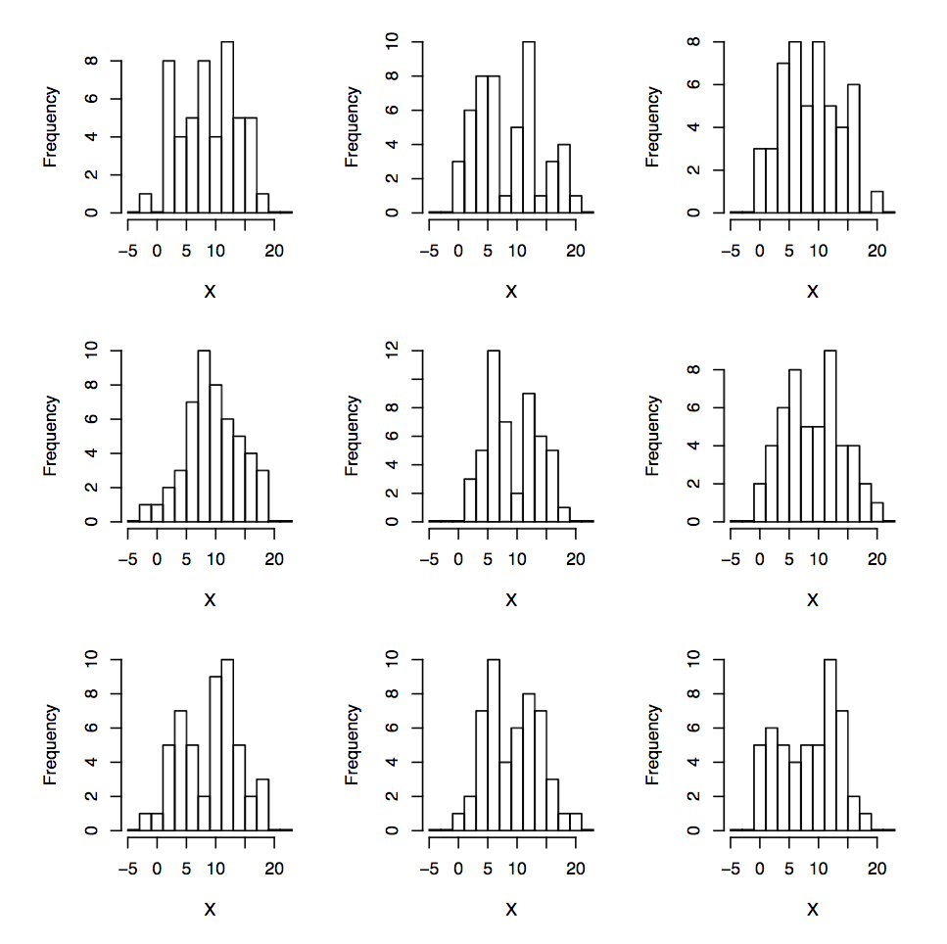
Sampling Error
9 samples of 50 each
same population as before
bin size = 2
histograms differ a lot
hard to judge true shape of population with just a few samples/bin
was the double peak real?
(probably yes; most of the histograms show it.)

Slide 18
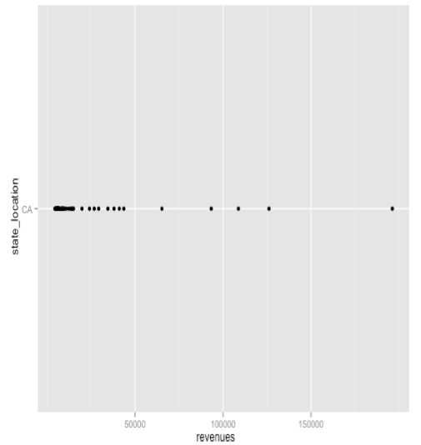
Alternative to histogram: Dot Plot
Problem: points can overly each other.

Slide 19
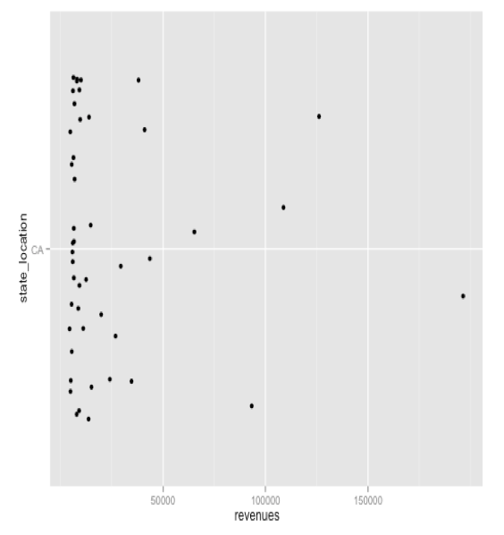
Refinement: Jitter Plot
Y coordinate means nothing.
Just keeps points from lying atop each other.

Slide 20
More precision: stem-and-leaf
Ex: # of hockey goals scored annually by Mario Lemieux
43 48 54 70 85 45 19 44 69 17 69 50 35 6 28 1 7
Like an ASCII histogram
Preserves 2 digits of precision for each sample
Easy to spot middle, outliers
Only for small sample sizes
0 | 1 | 6 | 7
1 | 7 | 9
2 | 8
3 | 5
4 | 3 | 4 | 5 | 8
5 | 0 | 4
6 | 9 | 9
7 | 0
8 | 5

Slide 21
Measures of Central Tendency
What is the one "most typical" value that best characterizes a data set?
It depends on:
how the data is distributed
what the data means
Candidates
Pythagorean means
arithmetic
geometric
harmonic
median
mode
others…

Slide 22
Geometric Mean
A mean value for multiplicative factors
Ex: a 3 year bank note with variable compound interest
5% in year 1
8% in year 2
3% in year 3
What constant interest rate would I need to have over a full 3 year period to equal the return on the variable note?
P * 1.05 * 1.08 * 1.03 == P * x * x * x = P * x³
1.05 * 1.08 * 1.03 = x³
x = (1.05 * 1.08 * 1.03)^{1/3}
In general, "the nth root of the product of n factors"
The key factor is that the interest in compounding
For simple interest, the arithmetic mean would give the correct answer

Slide 23




Harmonic Mean
A mean value for divisors
Ex: The time t required to cover a distance D is inversely proportional to the speed V
Suppose you drive n miles at 60 mph and another n miles at 75 mph.
What constant speed would cover 2 * n miles in the same amount of time?
➔ ➔
In general "the count n divided by the sum of the reciprocals"
Key factor: each segment of the trip is the same number of miles
If the segments were equal amounts of time, the arithmetic mean would be right

Slide 24
Comparing the 3 means
Arithmetic mean works for any set of numbers
Geometric and Harmonic means only make sense for sets of intrinsically positive numbers
For any set S of positive numbers. H(S) ≤ G(S) ≤ A(S) H(S) = G(S) = A(S) iff all numbers in S are equal
All 3 means can be thrown off by outlier values
Extremely large values can pull A(S) away from the center of S
Extremely small values (approaching 0) can distort H(S)
Both extremely large and extremely small values can distort G(S), but to a lesser extent than for A(S) and H(S)
A search for a less sensitive measure leads us away from means altogether.

Slide 25


Median Value
For any set S of N numbers in sorted order [s₁, s₂, …, s_{N} ], median(S) =
odd N ➔ (the middle value)
even N ➔ average of (two middle values)
Median is completely insensitive to outliers (and a lot of other stuff, unfortunately)
Median or mean for central tendency?
Use mean for symmetrical distributions without severe outliers
Use median otherwise

Slide 26
What about mode?
Mode is intuitively "the peak of the histogram"
Lots of problems:
more than one peak (Lord Rayleigh's nitrogen experiment)
flat broad peak vs. tall narrow peak
mode location extremely sensitive to sampling errors
Mode is (almost) never the best measure of central tendency
Useful as a secondary measure of distributions

Slide 27
Other central tendency measures
Quadratic mean (Root-Mean-Square)
used when the effect of a datum is proportional to its square
e,g., measuring varying voltage to estimate heating
Weighted means
outliers are counted less, but not zero
No one recipe is always best
Arithmetic mean or median suffices 95% of the time.

Slide 28
Measures of Spread
How far from the center does the data range?
2 classic measures
sample variance
percentiles (Tukey's 5 Number summary)

Slide 29
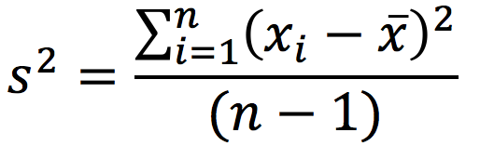
Sample Variance and Standard Deviation
Need at least 2 points in sample
Guaranteed to be non-negative
An instance of a second moment function
Squared terms make it very sensitive to outliers
Sample Standard Deviation (s.d.) is the square root of the variance.

Slide 30
Special Properties of Standard Deviation
Y% of points lie within X s.d. from the arithmetic mean.
Results for arbitrary data and for specific distributions
# s.d. | Any Data | "Bell Curve"
1 | n/a | 68.3%
√2 | 50% | 92%
2 | 75% | 95.5%
3 | 89% | 99.7%
4 | 94% | 99.994%
5 | 96%

Slide 31
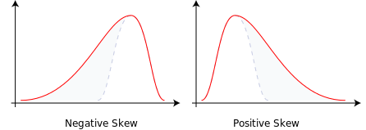
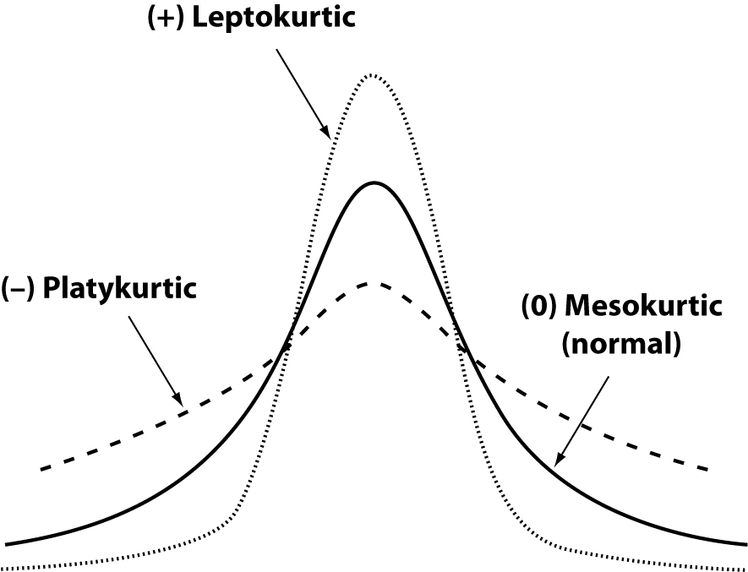
Deviations from "Normal" Data
Skew
Kurtosis

Slide 32
Tukey's 5-number summary
Divide samples into quartiles
Characterize by 5 points:
minimum value
maximum value
median
25th percentile (Q1)
75th percentile (Q3)
Inter-Quartile Range (IQR) = Q3 – Q1
very robust measure of spread
not affected at all by outliers
very stable from sample to sample
if data is "near" normal, IQR = 1.33 * s.d.

Slide 33
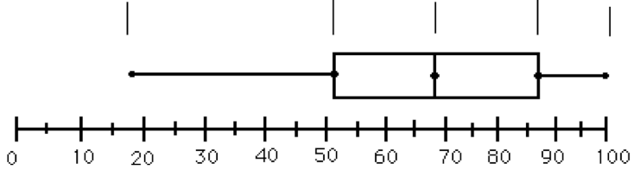
Box-and-whiskers plot
IQR
lower
limit
upper
limit
outliers
Q1
median
Q3
x
x
Q1, median, and Q3 are plotted directly
lower limit = greater of (minimum point, Q1 – k * IQR)
upper limit = lesser of (maximum point, Q3 + k * IQR)
(typically, 1.0 ≤ k ≤ 2.0)
Points outside the whiskers are defined as outliers
Points more than 2 * k * IQR outside box are extreme outliers
Plot can estimate skew, kurtosis, and much more (takes experience)

Slide 34
Understanding Outliers
Meaning of "outlier" depends on context
I mean "boxplot outliers"
May indicate a problem
Measurement errors
Transcription errors
Misidentified sample
Two different populations
A certain % are expected for most data (0.7% for normal)
Most plentiful for skewed or platykurtic data

Slide 35
EDA Example #1: Lord Rayleigh
Estimate weight of nitrogen
used a chemical compound to isolate a fixed amount of nitrogen
repeated this experiment 15 times
EDA made data easier to understand

Slide 36
Date | Source compound | Extraction method | Weight observed
29.11.93 | NO | hot iron | 2.30143
5.12.93 | NO | hot iron | 2.29816
6.12.93 | NO | hot iron | 2.30182
8.12.93 | NO | hot iron | 2.29890
12.12.93 | Air | hot iron | 2.31017
14.12.93 | Air | hot iron | 2.30986
19.12.93 | Air | hot iron | 2.31010
22.12.93 | Air | hot iron | 2.31001
26.12.93 | N₂O | hot iron | 2.29889
28.12.93 | N₂O | hot iron | 2.29940
9.1.94 | NH₄NO₂ | hot iron | 2.29849
13.1.94 | NH₄NO₂ | hot iron | 2.29889
27.1.94 | Air | ferrous hydrate | 2.31024
30.1.94 | Air | ferrous hydrate | 2.31030
1.2.94 | Air | ferrous hydrate | 2.31028

Slide 37
Box Plot + Jitter Plot
That looks really weird
What's off?
aha!
Two different populations
2.3105
2.3080
2.3055
2.3030
2.3005
2.2980

Slide 38
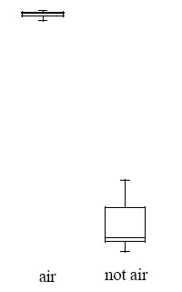

2 separate box plots
2.3105
2.3080
2.3055
2.3030
2.3005
2.2980
air
not air

Slide 39
How Normal is my Data?
Compare sample with a known distribution
Normal "bell curve" distribution is a common choice
Visually determine how well a particular distribution fits (there are alternate numerical methods, but visuals tell more)
Tool of choice: Probability Plot
Graph percentiles of your sample (y) vs. theoretical percentiles (x)
All you need is available in "inverse distribution" tables
Need to "standardize data" first
if reference distribution is symmetric about zero, subtract arithmetic mean from each data point
divide each data point by the s.d.

Slide 40
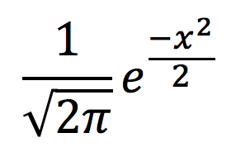
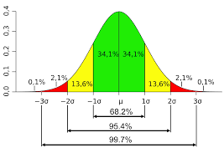
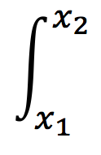
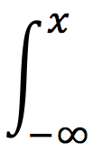
The Standard Normal Distribution
Like a histogram, but smooth curve
Continuous, so likelihood of any specific value is zero
Height of curve = relative likelihood of finding a value near that x value
Curve never reaches zero
Total area under curve = 1 (100%)
Prob. of random value between x₁ and x₂ is the area between them
So, prob. of random value being < x:
There are tables for this!
-3 -2 -1 0 1 2 3

Slide 41
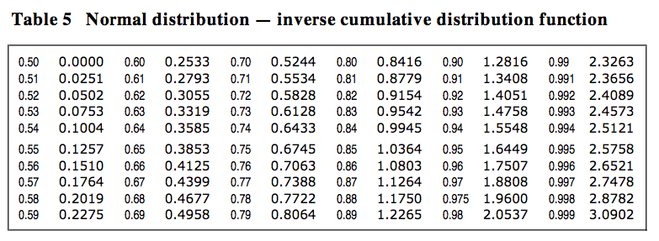
Probability plot intuition
Suppose 10 points
Divide unit line into 10 segments
0.0 – 0.1, 0.1 – 0.2, etc.
Make list of midpoint of each segment, so [0.05, 0.15, 0.25, ... ]
For each midpoint find corresponding point in distribution table: [-1.6449, -1.0364, -0.6745, … ]
Scatter plot distribution points vs. sample points (distribution point = x, sample point = y)
Add 45 degree horizontal line through origin

Slide 42
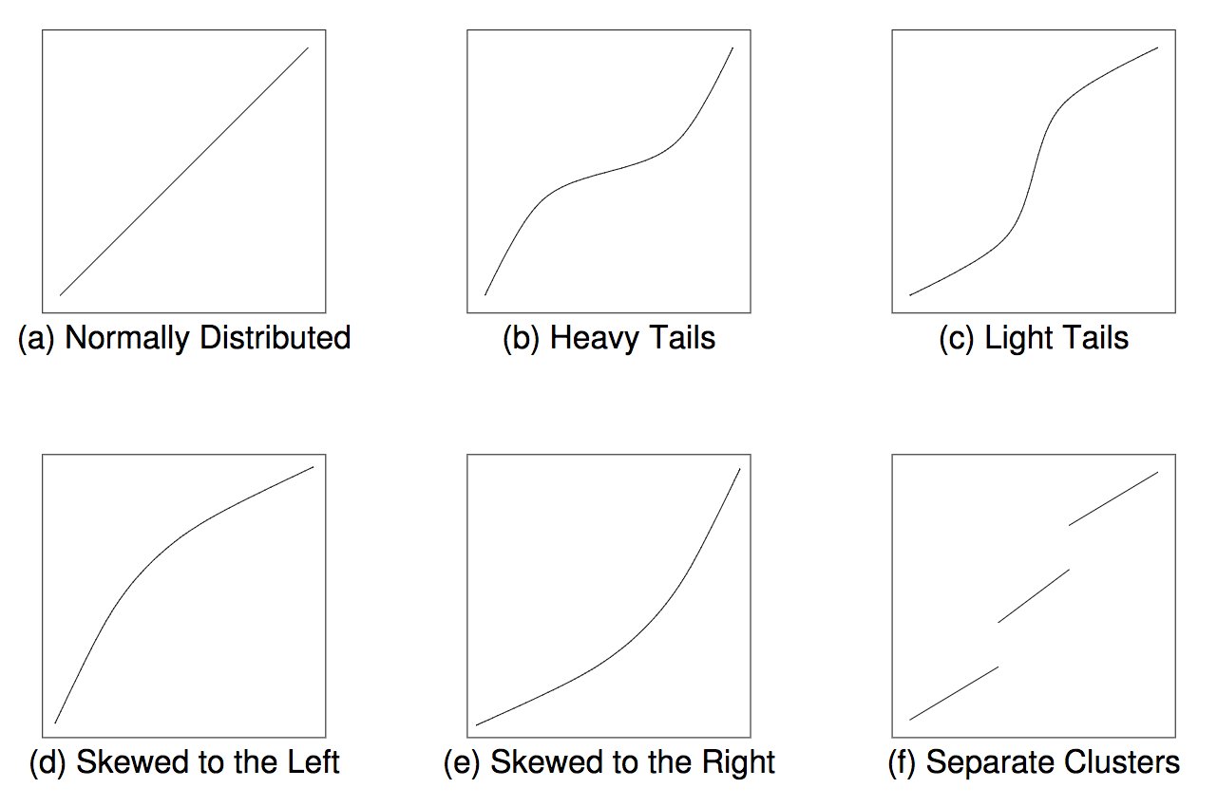
"Not quite normal"
no skew
no skew

Slide 43
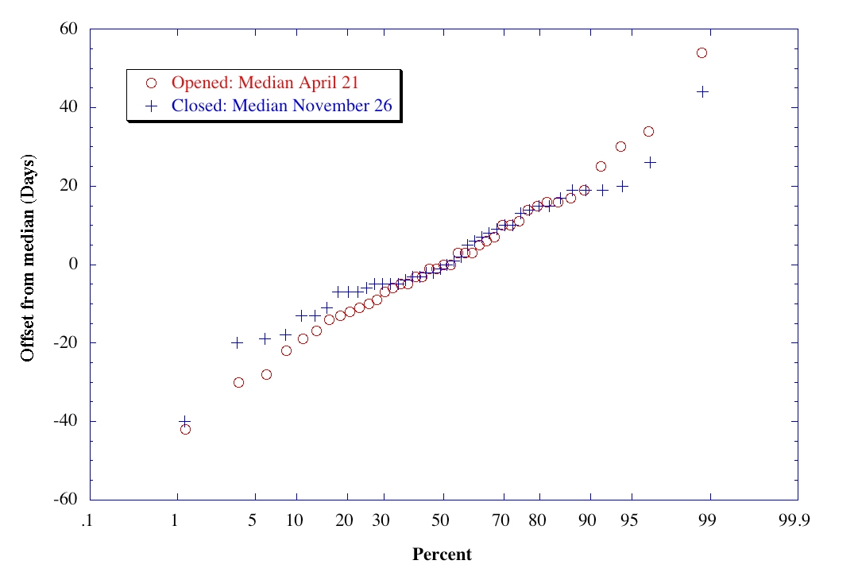
Natural Data is more Complex (seasonal closings of Washington State Route 20)
Variations sometimes seen:
Label X axis with %, not s.d.
"de-standardize" Y axis
reference line passes through Q1, Q3 instead of through (-3sd, -3sd) and (+3sd, +3sd)
By Walter Siegmund - Own work, Public Domain, https://commons.wikimedia.org/w/index.php?curid=2927749

Slide 44
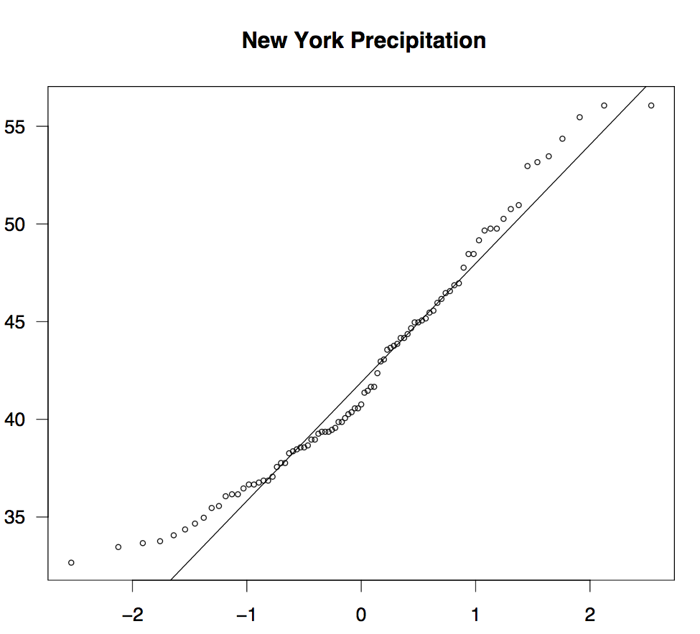

Slide 45
Pair of Variables: Both Categorical

Slide 46
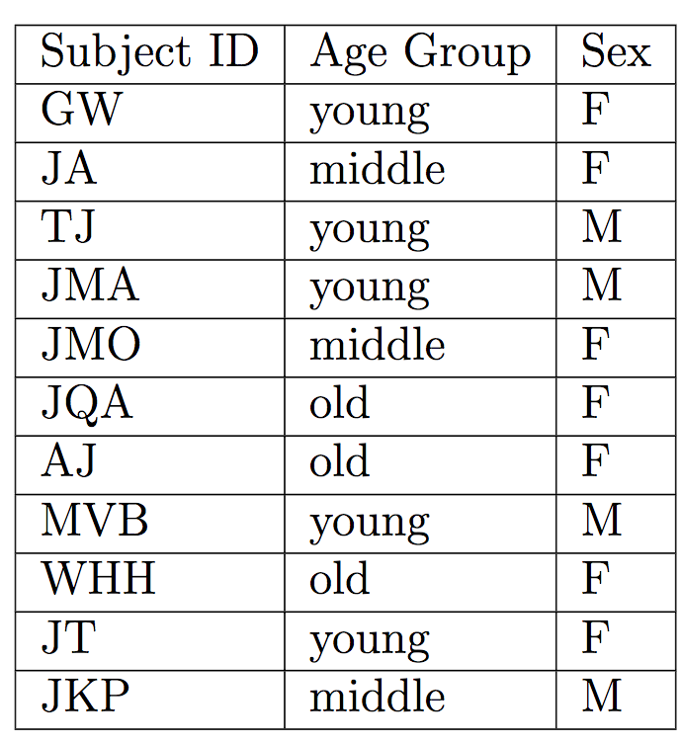
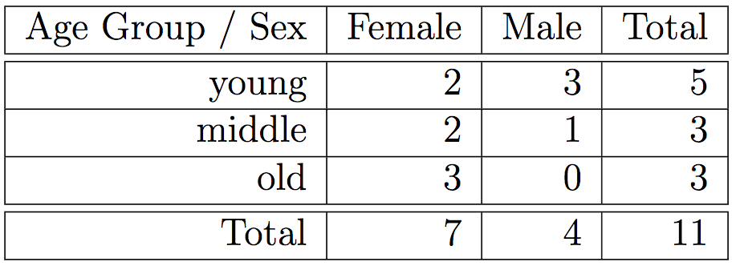
Cross-Tabulation
Sample data with 2 Variables
Cross-Tabulation of Sample Data
Can be absolute counts or %
Can be extended to 3 variables
More than 3 gets harder

Slide 47
Correlation of Categorical Variables
 | Yes | No | Total
Men | 46 | 63 | 106
Women | 95 | 113 | 208
Total | 138 | 176 | 314
Does the value of variable A affect statistics for B?
Are the responses for Men and Women actually different? (or is this in the range of sampling error?)
Standard but non-graphical methods for answering this.

Slide 48
Pair of variables: One categorical, One Numeric

Slide 49
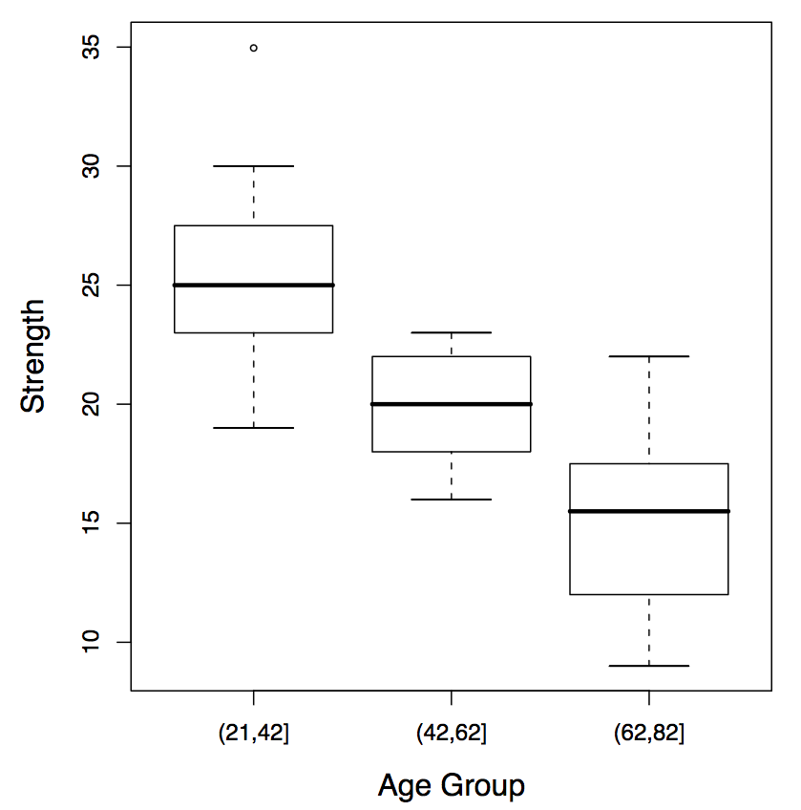
Stacked Box-and-Whiskers
Survey includes:
sex
political affiliation
age range
strength test
Q: Does age and strength interact?
A: Yes Not actually proven but strongly indicated.

Slide 50
Stacked Box-and-Whiskers
Q: Does party affiliation affect strength?
A: Probably not.
At best a weak effect
Means are possibly different (standard error bounds)
x
Dem Rep

Slide 51
Pair of Variables: Both NUMERICAL

Slide 52
Scatterplots
The basis of visual analysis
For each reading [a_{i}, b_{i}], plot a_{i} as the x coordinate and b_{i} as the y coordinate.
Scatterplots may have various shapes, each with a meaning:
a round or squarish "cloud" of points
an oblong cloud, perhaps tilted
points closely following a line or curve
several disjoint clouds of points
Scatterplots can diagnose many kinds of dependence between variables that simple numerical tests miss

Slide 53
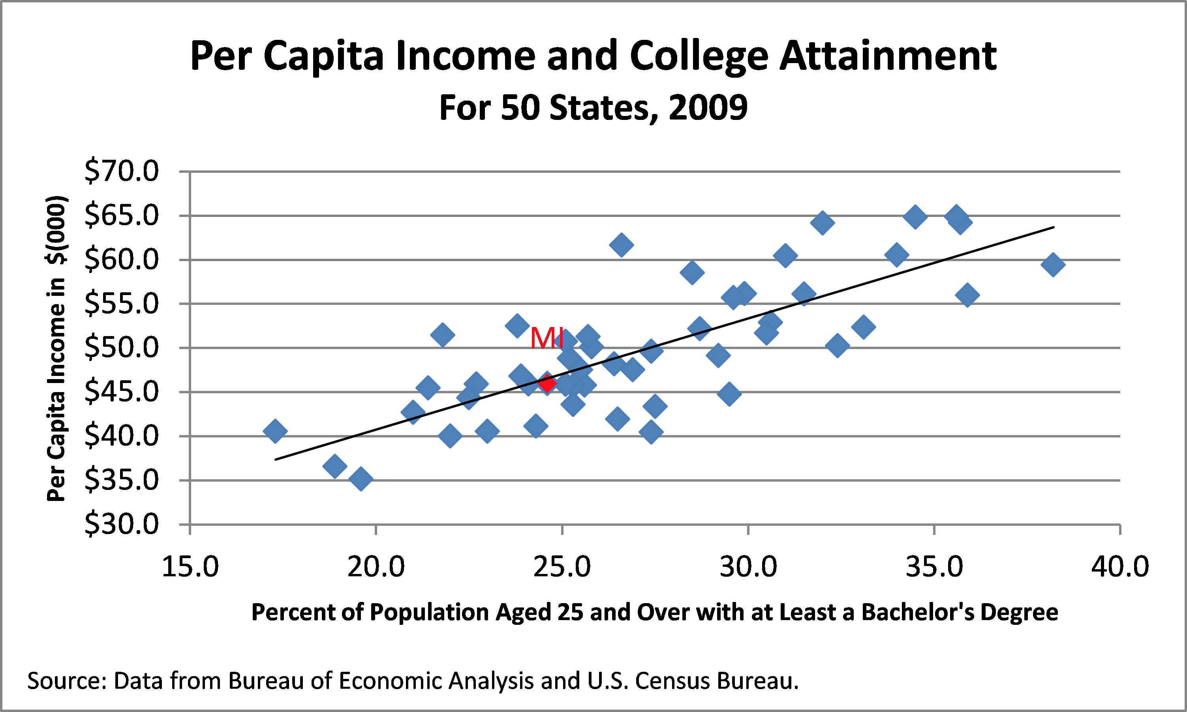
Classic "oblong cloud"
Tilt up and to the right means that more education usually makes income rise. (moderately strong "positive correlation")
"oblong-ness" indicates how predictable the relationship is
Line is a "regression line"

Slide 54
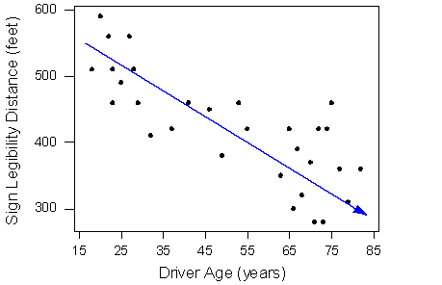
Sign Legibility Distance (feet)
Driver Ave (years)
This cloud is sloping the other way, indicating a inverse relationship between age and visibility.
Oblong shape is pronounced: moderately strong correlation again

Slide 55
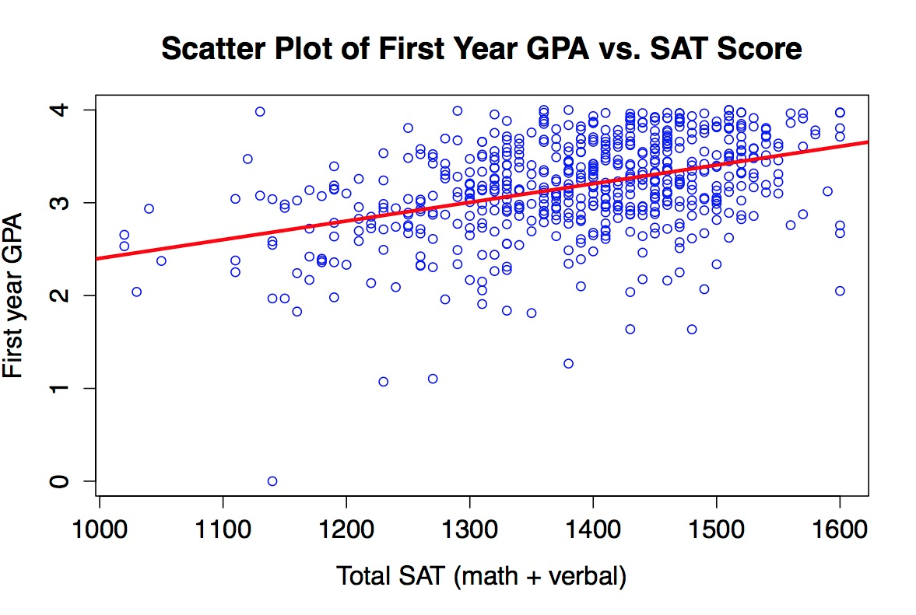
upward trend is still there, but less well defined
the cloud is a lot cloudier
best guess (line) is that correlation is still slightly positive

Slide 56
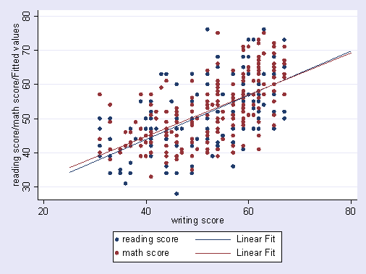
Scatter Plot for three variables separated by color.
Vertical bars are because X axis domain is discrete
Some positive correlation, but a lot of noise
Too much data here?

Slide 57
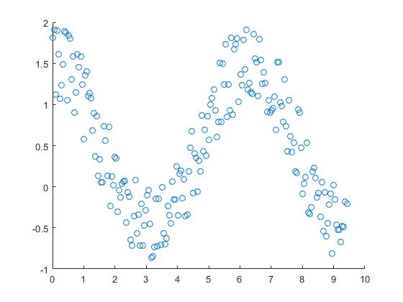
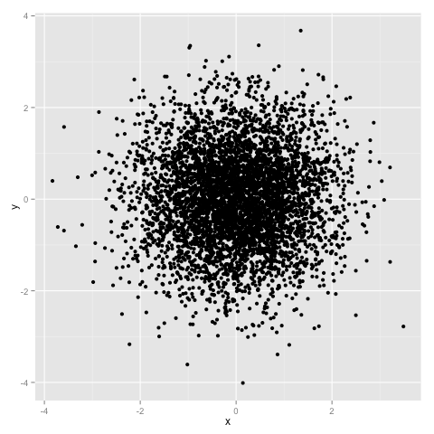
X and Y are uncorrelated in both, but what a difference!
On the left, X and Y are clearly dependent, but uncorrelated.
i.e., an increase in X is equally likely to be associated with either an increase or decrease in Y
Numerical correlation measures don't mean much without a scatterplot

Slide 58
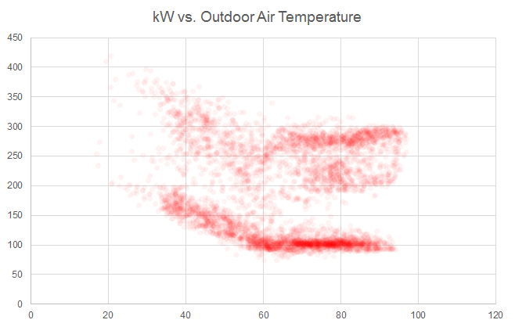
Outdoor Temp. vs. Electrical consumption for Office Building
Two distinct clouds, one above the other
Clouds are flat above 60 degrees
Clouds rise to the left below 60.
What's the story here?

Slide 59
Two sets of measurements taken under different conditions
Individually they have a strong negative correlation
Together, they have a moderate positive correlation
What is the real correlation value?

Slide 60
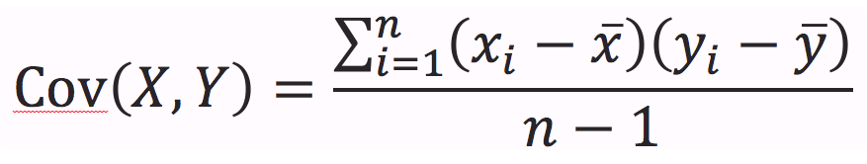
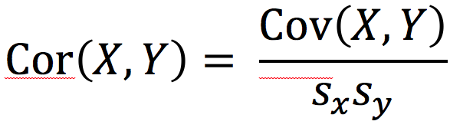
Computing Correlation
Covariance, like variance has weird units
Correlation is covariance normalized to the geometric mean of the variances of the two variables.
Range of correlation is [-1, 1] with 0 meaning uncorrelated
Numerical correlation is only meaningful when scatter cloud is "typical"

Slide 61
Quantile-Quantile (QQ) Plot
Sometimes you don't have a specific distribution in mind
You need to see if Samples S1 and S2 come from the same distribution, whatever it is.
Plot the standardized samples for S2 (y) vs. S1 (x)
Checks relative skew and relative kurtosis.

